Slide 1
Performance Testing
Process in CTS

Slide 2
Performance Testing Process
Performance requires a holistic approach
A structured approach is a must to identify a cause rooted in single or multiple components

Slide 3
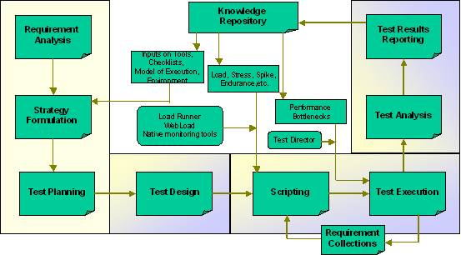
Performance Testing Process

Slide 4
Step1: Requirement Analysis
The requirement collection phase includes
  Initial analysis
  Study of the application
The deliverable to the client is the Requirement Collection document
Analysis phase includes
  Identifying system components
  Describing the System Configuration
  Analyzing the Usage Model
  Defining Testing Objectives

Slide 5
Step2: Test Planning
The test plan phase includes
  Laying out of the detailed plan that is based on the Requirements Collection document
The deliverable to the client is a Test Plan document and Transaction traversal document with the following contents:
  Objective
  Resource Requirements (Hardware, Software, People)
  Technical Requirements (Features to be & not to be tested, Test Entry & Exit Criteria, Test data)
  Customer Requirements
  Test Deliverables
  Risk Assessment
  Limitations and Assumptions
  Task Summary

Slide 6
Step3: Test Design
Test Design phase includes
  Designing and development of the test scripts
  Monitoring tools required for each component in the architecture of the system are identified
Deliverable for this phase
  Test design document, which is an internal document
  Test scripts

Slide 7
Step4: Test Execution
Test execution phase includes
  Running the actual tests
  Collecting statistics for analysis
Smoke Run
  Initially performed preliminary run
  Aims at the stability and correctness of load generation
  Aims at results from monitors

Slide 8
Step5: Analysis of Results
Most important phase.
The result data is analyzed for system performance and bottlenecks are identified at the end of the test run
Deliverable to the client is the preliminary report
  Focuses mainly on the key findings
  Recommendations for the current setup
(Note: Step4 and 5 are iterative process and is executed until the performance of the application is satisfactory)

Slide 9
Step6: Report Submission
At the end of performance tests
  All the runs performed are correlated
  Summarized into an Executive summary report
The deliverable is Executive Summary Report, with the following contents:
  Objectives
  References
  Test Setup (Hardware Configurations, Software Configurations, Tool Settings, List of Transactions, Scenarios Tested, Client machines configurations, Transaction generation pattern)
  Test Results (List of Significant Runs, Scalability Statistics, Response Time Statistics, Server Side Statistics)
  Findings, Recommendations and Test Log
  Appendix

Slide 10
Documents
Performance Test Requirement Collection
Refer to Performance Test Requirement Collection - Template.doc file
Performance Test Plan
Refer to PerformanceTestPlan_Master.doc file
Performance Test Report
Refer to PerfTestReport-Preliminary.doc file
Script Check List.doc
Refer to ScriptCheckList.doc file

Slide 11
Questions & Answers
Session

Slide 12
Thank You

